Slide 1
Hands-on
discuss SPGs of aquatic invertebrates
discuss available DLT simulation outcome
Do analysis, outcome
Material: HDF arr.dat, HDF viewer, Jupyter Notebook

Slide 2
Hands-on
Case Study | Regulatory Framework of Higher-tier Landscape-level Aquatic Risk Assessment in Europe

Slide 3
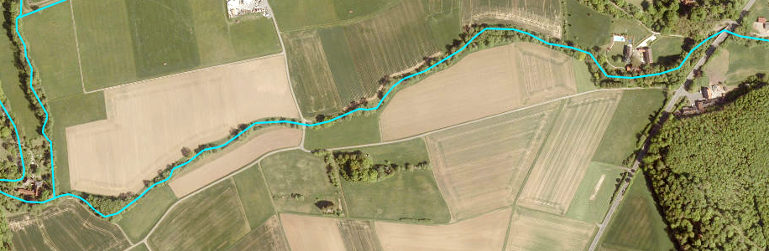

xLandscape Case Study Context: Aquatic Risk Assessment
Risk of aquatic invertebrates due to insecticide use in arable crops.
A classical use of Landscape Modelling!
Notes:
introduce and emphasise the use of xAquaticRisk in the classical RA context (EU, aquatic guidance document, SPGs.

Slide 4


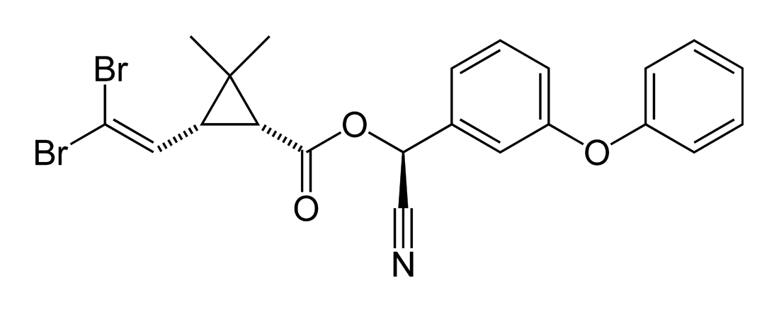
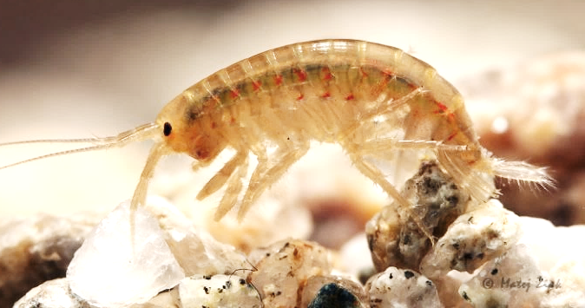
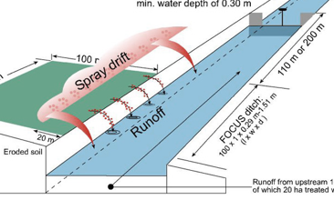
Problem Formulation: lower Tier indicated risk
Pyrethrum is known as insect pest control since antiquity (Persian insect powder). Synthetic derivatives, pyrethroids, appeared in the 1970s, which overcome photoinstability of natural ancestors and which toxicity is selective to arthropods (→SupportingDocs).
There is a high demand for phyrethroid pest and vector control (eg, cicada Philaenus spumarius spreading Xylella fastidiosa, killing olive trees). Pyrethroid pesticides are authorised in many crops (eg, cereals, oilseed, soybeans, fruit, olives, cotton, vegetables, rice), in countries across the world.
Key environmental concern is the very high toxicity to aquatic invertebrates
We assume a Regulatory Acceptable Concentration of RAC ~ 1 ng/L
If exposure, PECsw ≤ RAC ⇒ Risk acceptable
Our CaseStudy 'SynPyrethroid' is used in arable crops, at an application rate of 1x 7.5 g a.s./ha
Standard, edge-of-the-field exposure assessment results in PECsw_FOCUS ~ 2 ng/L →unaccepable risk
FOCUSsw approach
Objectives →Higher-Tier Risk Assessment for Aquatic Invertebrates
Make exposure assessment more realistic. Design approach guided by Specific Protection Goals.
Link effect to exposure modelling. Identify effective risk management measures. Support weight-of-evidence assessment.
Responsibility and Innovation: increase knowledge on real-world exposure and effects, also for next generation of approaches.
FOCUS Surface Water Scenarios (2001) SANCO/4802/2001 rev. 2; FOCUS Surface Water (2015) Generic guidance v 1.4
Notes:
this case study represent THE classical use of landscape modelling in risk assessment of pesticides . emphasise and highlight the key terms that characterises a higher-tier RA. suggest to participant to get deeper into the topic. Innovation and responsibility

Slide 5
Questions, Discussion Points
Why move to higher-tier/Tier4? FOCUS gives ~2 ng/L while the RAC is ~1 ng/L (unacceptable at lower tier). What exactly would you need to see (data or model evidence) to justify moving to a Tier‑4 landscape approach—and what would count as “more realistic” in this case?
SPGs as the steering wheelWhich SPG “dimension” is most decisive for choosing endpoints in this training—entity, attribute, magnitude, temporal scale, spatial scale, or certainty—and why? (Pick one and defend it.)
ETO vs ERO (threshold vs recovery). Which extra efforts will the ERO bring to higher-tier landscape modelling approach for an insecticide. For pyrethroids and aquatic invertebrates, when would you argue for an Ecological Threshold Option (ETO) versus an Ecological Recovery Option (ERO)? What kind of evidence would you consider “strong enough” to support ERO?
What changes from FOCUS → Tier‑4 (and what doesn’t)?What is fundamentally different when going from a Step 3/4-style exposure–RAC comparison to a Tier‑4 landscape coupling of exposure and effects—and what conservative assumptions may still remain even at Tier‑4?
The “ensemble” idea (protecting the system, not every ditch)The slides argue for protecting an ensemble of edge‑of‑field waters rather than each single segment. How would you explain (to a regulator or stakeholder) why that is still protective—and where you would draw the line for unacceptable hotspots?
Endpoints & percentiles: what do they mean in practice?When you see “spatial percentiles” and “temporal percentiles” of PECsw(x,t), what real-world protection statement are you making? Which percentile combination feels defensible for decision-making—and why?
Exposure framing choice: “Exposed-only streams”What changes (conceptually and numerically) when you switch to an “exposed-only streams” analysis? In which regulatory contexts could this be justified, and where could it be misleading?
Mitigation: from simulation result → practical ruleThe mitigation example (buffer + drift reduction) shows large reductions. How would you translate that into a simple, auditable risk‑management rule (e.g., targeted hotspots vs blanket mitigation), and what extra information would you need?
Optional “hands-on starter” (quick warm-up question)If you want a 60‑second opener before the notebook work:What would you expect to be the biggest practical bottleneck today: understanding SPGs, finding/QA’ing parameterisation data, running the simulation workflow, or interpreting output percentiles?

Slide 6
Questions, Discussion Points
1. Why move to Tier‑4?
FOCUS gives PECsw ≈ 2 ng/L while RAC ≈ 1 ng/L. What *specific* evidence would justify a Tier‑4 landscape approach—and what does “more realistic” mean here?
2. SPGs as the steering wheel**
Which SPG dimension most strongly drives endpoint choice in this case (entity, magnitude, spatial scale, temporal scale, certainty)? Why?
**3. Threshold or recovery? (ETO vs ERO)**
For pyrethroids and aquatic invertebrates, when would ERO be defensible—and what evidence would regulators need to see?
**4. What really changes at Tier‑4?**
Compared to FOCUS Step 3/4, what is fundamentally different when exposure and effects are *coupled* at landscape scale—and which conservative assumptions still remain?
**5. Protecting an “ensemble”, not every ditch**
How would you explain to a regulator why protecting an ensemble of edge‑of‑field waters is still protective? Where do unacceptable hotspots begin?
**6. Percentiles = protection statements**
What real‑world protection claim do spatial and temporal PECsw percentiles make? Which percentile combination feels defensible for decisions?
**7. “Exposed‑only streams” framing**
What changes conceptually and numerically when analysing only exposed stream segments—and when could this be misleading?
**8. From model output to mitigation rule**
How would you translate the mitigation results into a simple, auditable risk‑management rule (hotspot‑targeted vs blanket)?
### *(Optional speaker notes – keep hidden)*
* These questions mirror the **story arc of the training**: problem formulation → SPGs → Tier‑4 design → endpoints → mitigation.
* There are **no single correct answers**; the goal is to surface assumptions and trade‑offs.
* Encourage participants to answer **as if they were the risk assessor**, not the modeller.
* If time is short: use **Q1, Q3, and Q6** as a minimal set.

Slide 7

Supplement Regulatory Acceptable Concentration (RAC)
The Regulatory Acceptable Concentration (RAC) is the maximum concentration of a pesticide in the environment that is considered safe for non‑target organisms. At Tier 1 (standard lab tests), the RAC is usually:
Typical steps:
Select endpoint: Acute: LC50/EC50 for fish, invertebrates, algae, macrophytes. Chronic: NOEC/EC10 for sensitive taxa.
Choose the most sensitive relevant endpoint: Often the lowest chronic NOEC/EC10 across taxa is used for long‑term RACsw.
Assessment factor (AF). Applied to account for uncertainty: 10 for strong chronic datasets, 50–100 for acute data
Higher‑tier options (SSD and mesocosms): When Tier‑1 is too conservative or fails, EFSA’s aquatic guidance allows refinement
Species Sensitivity Distributions (SSD): Use multiple chronic endpoints (e.g. EC10/NOEC for many species). Fit an SSD and derive an HC5 (hazard concentration for 5% of species). Apply a smaller AF (e.g. 1–5) to HC5 → refined RAC.
Micro‑/mesocosm studies (model ecosystems): Expose realistic aquatic communities to the pesticide. Identify the highest concentration with negligible or acceptable population‑level effects, depending on the protection goal. This concentration (possibly with a small AF) becomes the RAC
ETO vs ERO (protection goal choice). EFSA distinguishes two protection goal options for deriving RACs from higher‑tier data:
Ecological Threshold Option (ETO): Only negligible effects at population level are allowed. RAC is set at the highest concentration with no or only minor, transient effects.
Ecological Recovery Option (ERO): Some initial population‑level effects are allowed if recovery occurs within an acceptable time (e.g. within weeks). RAC can be higher than the ETO‑RAC, but must be justified by clear recovery in the mesocosm data.
Once the aquatic RACsurfacewater/sediment is set, it is compared with modelled or measured exposure: eg, PECsw ≤ RACsw → aquatic risk acceptable
If the risk is not acceptable, regulators may require risk mitigation (eg, buffer zones, drift‑reducing nozzles, reduced application rates) or they may reject the product.
At lower (standard) tiers, PECsw/sed are calculated using the FOCUSsw approach, at higher-tier landscape models and scenarios come in, eg, xAquaticRisk

Slide 8
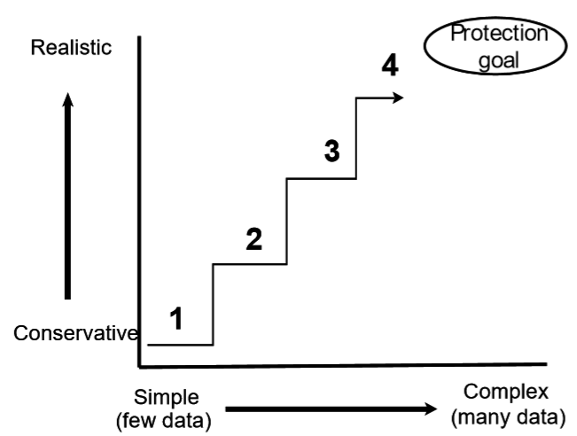
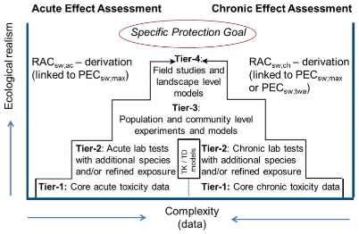
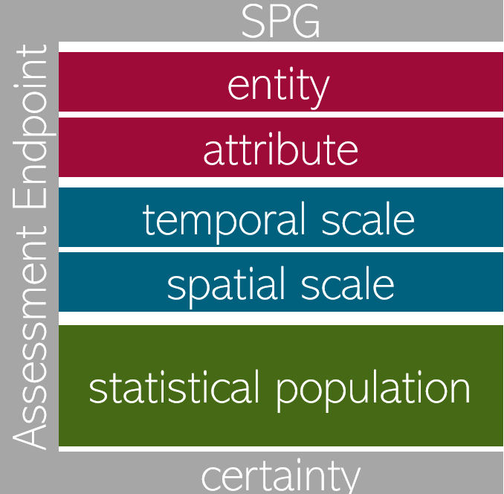

why can we do that?! Tiered Aquatic Risk Assessment (EU)
Key: Higher-Tier Approach guided by Specific Protection Goals. Supporting evidence.
Assessment: acceptable effects? →Quantify Exposure and Effects in Dimensions and Scales defined in SPGs
Same protection goal at all tiers
*SPG=Specific Protection Goal
Regulation EC 1107/2009, Data Requirements, Uniform Principles, Aquatic Guidance Document, Sustainable Use Directive, EFSA Scientific Opinions on Specific Protection Goals, PPR Panel scientific opinions on recovery in aquatic organisms/ecological threshold concepts, EFSA/PPR opinions and guidance on TKTD, EFSA uncertainty + weight-of-evidence guidance, FOCUS Surface Water, …

Slide 9
Supplement Risk
→
MODULE | Regulatory Framework of Higher-tier Landscape-level Aquatic Risk Assessment in Europe

Slide 10
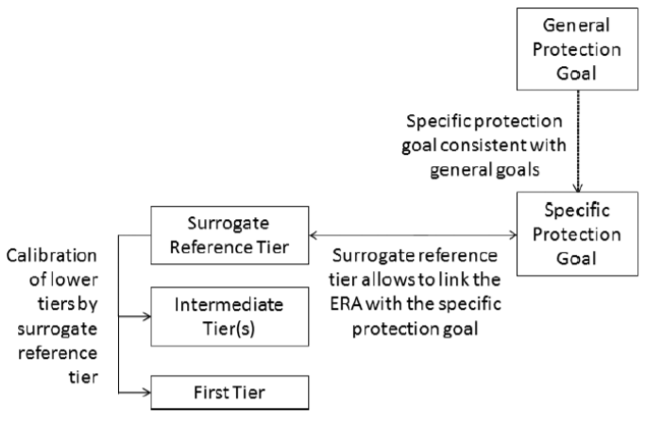
Supplement Regulations framing higher-tier risk assessment
→
MODULE | Regulatory Framework of Higher-tier Landscape-level Aquatic Risk Assessment in Europe

Slide 11
Supplement Specific Protection Goals

Slide 12
Supplement TKTD, GUTS

Slide 13
how to make an appropriate Tier-4 modelling – how to design ‚more realistic‘?!
what drives the aquatic exposure for SynPyrethroid

Slide 14
which variability do we address
modelling variability
‚resolve‘ variability
Monte Carlo

Slide 15
The Modelling Approach xAquaticRisk
Modular
Open Source, FAIR
Makes use of regulatory established models
Flexible, adaptable
Environment
Ag/Land.Mgmt
Exposure/Efate
Effect
Analysis
xDrift
StreamCom
Population
Stream Network
Crop cultivation
MASTEP
Hydrology
xRunoff
Steps1234
LP50
PPP use
GUTS
Water temperature
xDrainage
Toxswa
Exposure
CVASI
Spatiotemporally explicit Modeling Framework Interfaces ▪ Control ▪ MonteCarlo ▪ Dimensions ▪ Scales ▪ Semantics
(https://github.com/xlandscape/xAquaticRisk)

Slide 16
The Modelling Approach xAquaticRisk
Modular
Open Source, FAIR
Makes use of regulatory established models
Flexible, adaptable
xDrift
GUTS
Population
Stream Network
Crop cultivation
MASTEP
Hydrology
xRunoff
Steps1234
LP50
PPP use
CVASI
Water temperature
xDrainage
Toxswa
Exposure
StreamCom
Spatiotemporally explicit Modeling Framework Interfaces ▪ Control ▪ MonteCarlo ▪ Dimensions ▪ Scales ▪ Semantics
(https://github.com/xlandscape/xAquaticRisk)

Slide 17


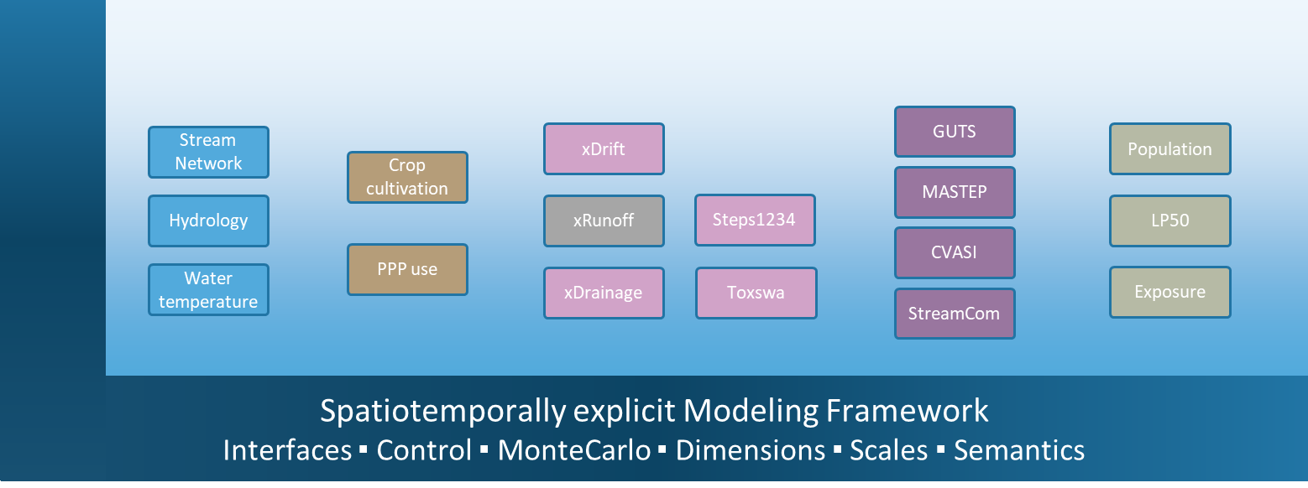
The Modelling Approach xAquaticRisk
Modular
Open Source, FAIR
Makes use of regulatory established models
Flexible, adaptable, integrated
User get in touch with a single model
(https://github.com/xlandscape/xAquaticRisk)

Slide 18
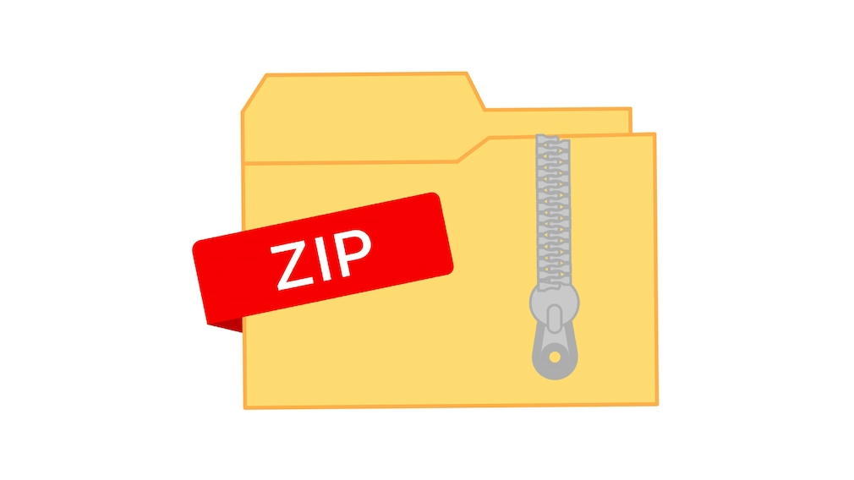
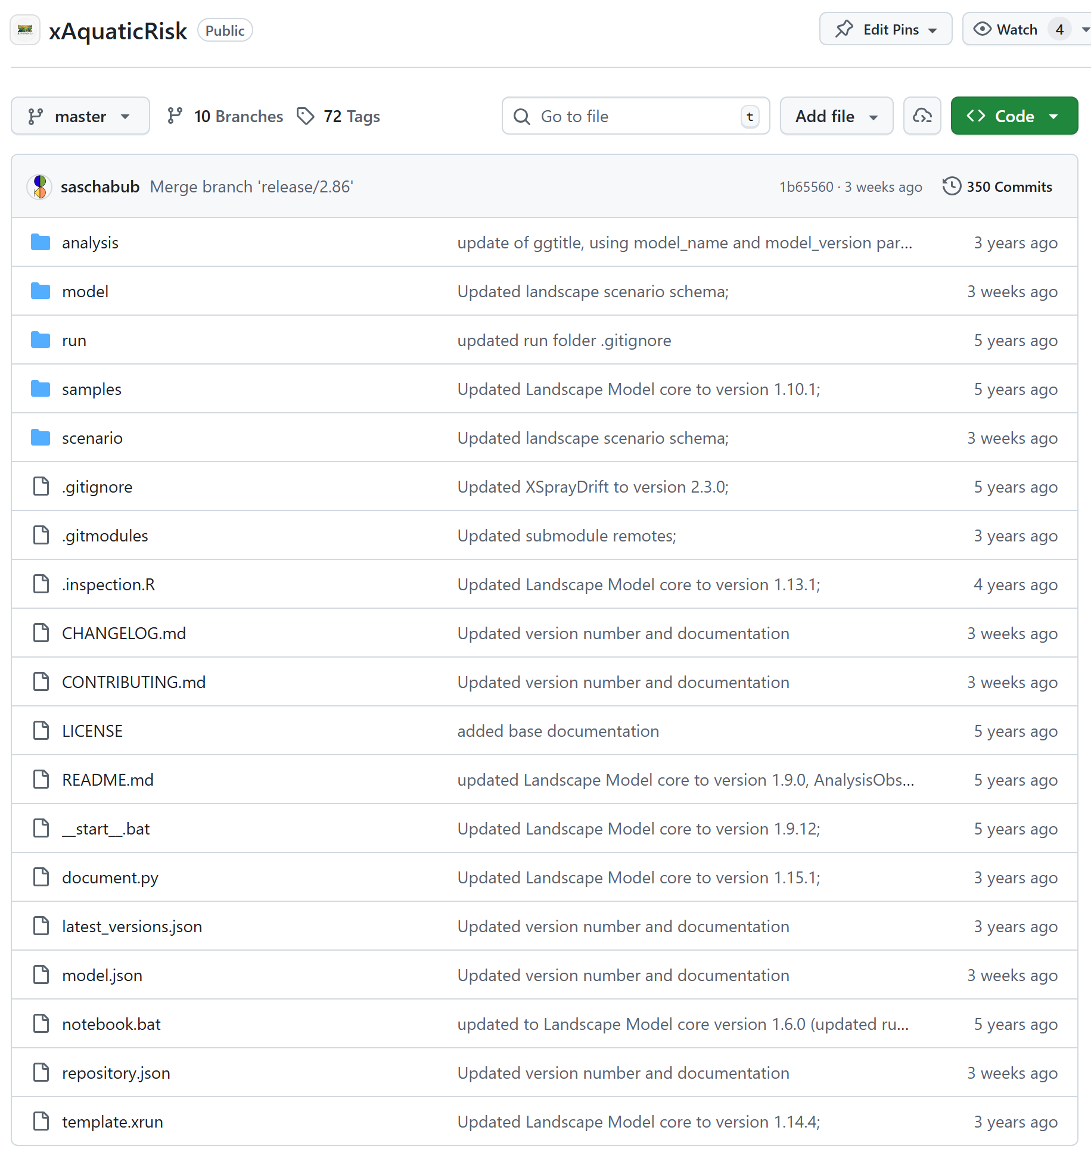

Get xAquaticRisk no installation needed
download or clone from
xAquaticRisk.zip Github

Slide 19
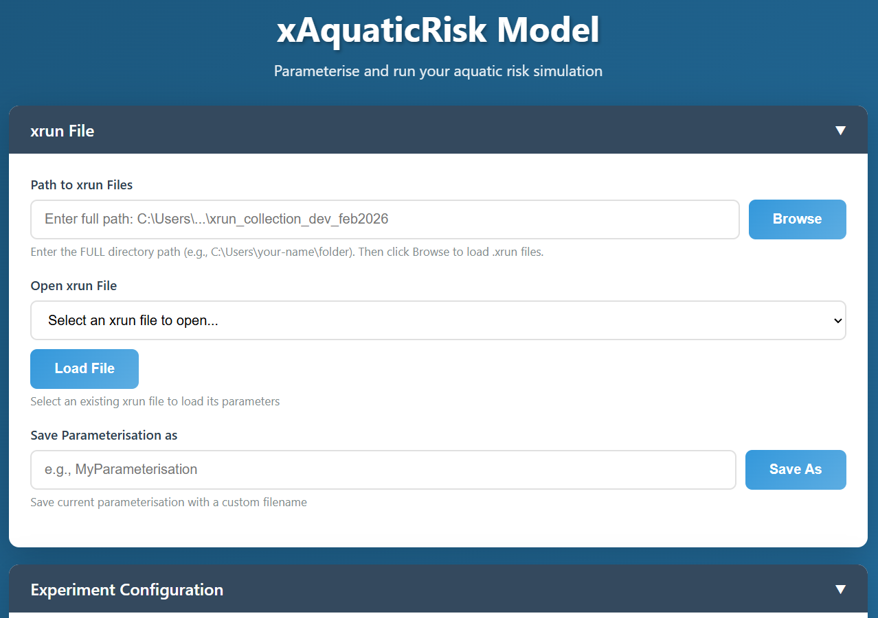
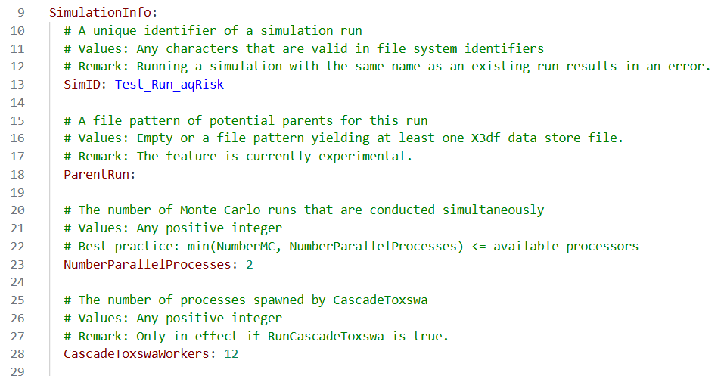
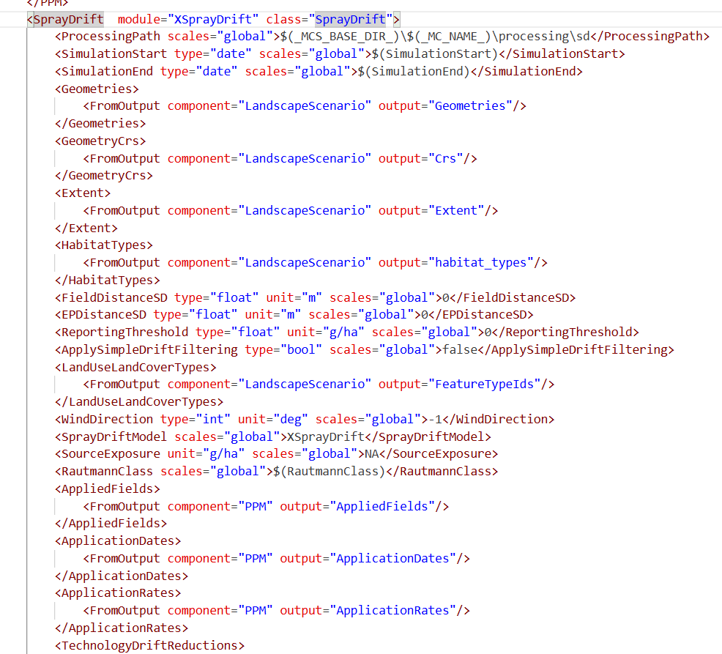
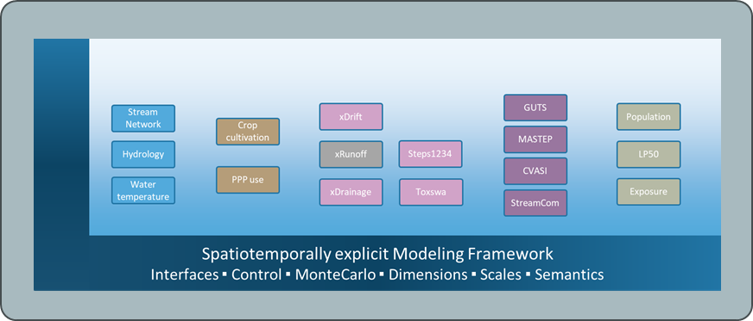
Parameterisation
User Interface - WebUI
Parameterisation (.xrun, .yaml)
Configuration – mc-xml

Slide 20
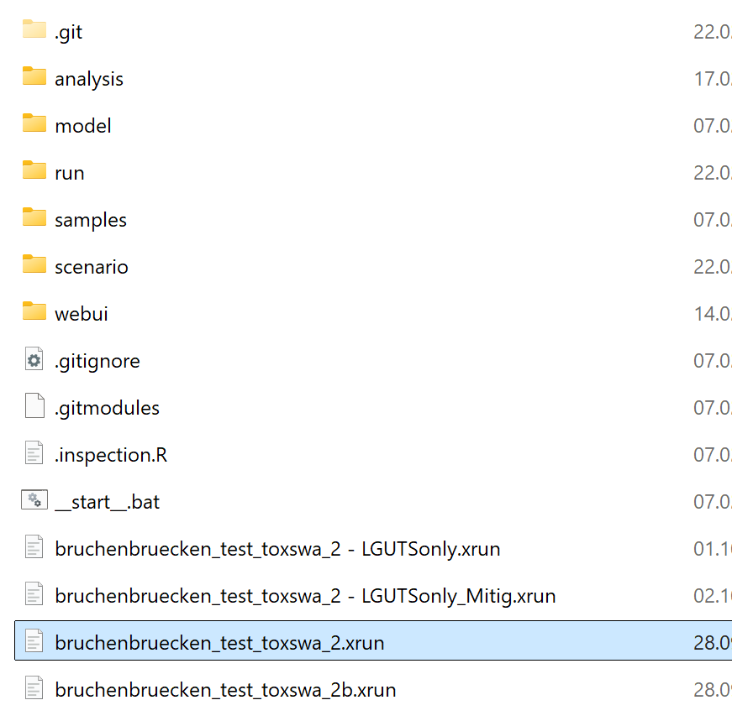
Start a Simulation
Drag and Drop
your …xrun file
onto the
__start__.bat

Slide 21
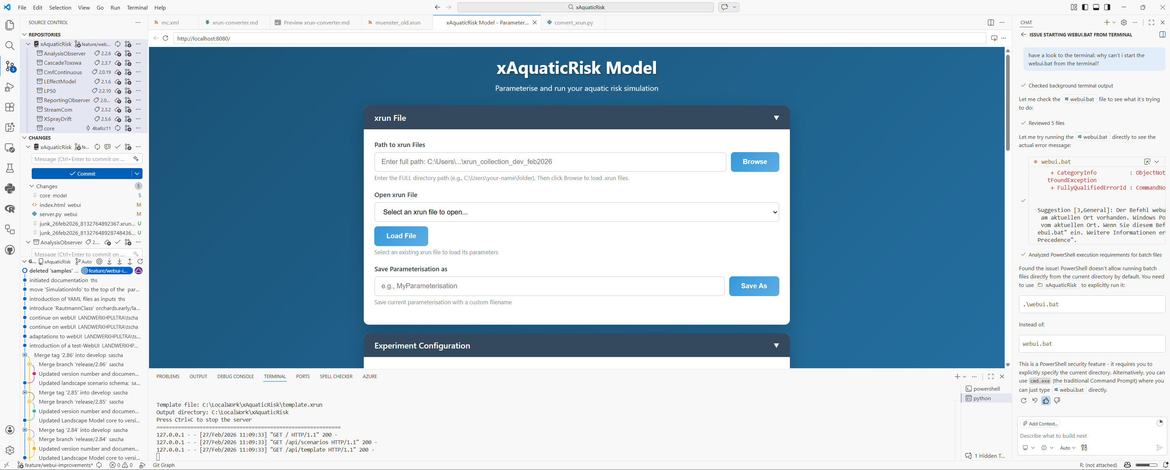
Advanced your IDE as xLandscape Operation Center
Visual Sudio Code (example)
Git, development, modelling, analysis, documentation
..all AI-suported

Slide 22
Scenario – Wetterau
Module→Scenario development
show the Wetterau and the upper subcatchment ‚Münster‘

Slide 23
Concepts for Landscape-scale Aquatic RA / SPGs as Basis
Basis: Specific Protection Goals (SPGs) for aquatic invertebrates, Aquatic Guidance, TKTD GD, …
EFSA defines (SPGs) for aquatic invertebrates by linking ecological functions (below) to population-level endpoints:
Entity to protect: Populations of aquatic invertebrates (not individuals)
Attribute to protect: Abundance and structure (e.g. species composition)
Magnitude of effect: either negligible (Ecological Threshold Option, ETO) or recoverable (Ecological Recovery Option, ERO)
Temporal scale: Recovery within a defined time frame (e.g. 8 weeks)
Spatial scale: Edge-of-field surface waters (e.g. ditches, ponds, streams)
SPGs are based on key roles of aquatic invertebrates in surface water:
Decomposition and nutrient cycling
Food web support (e.g. prey for fish and amphibians)
Water quality regulation
"Protecting populations ensures these functions remain intact even if some individuals are affected" (EFSA)

Slide 24
Concepts for Landscape-scale Aquatic RA / Design
→Design of Tier-4, landscape-scale exposure and effect assessment:
General: Tier-4 = higher-tier, dh introduce more reality (land use, landscape structure, exposure-source to aquatic system relationship, exposure-driving factors (eg wind), habitat quality, species occurrence, efate…)
Natural catchment as basis (='statistical population', by natural watersheds, no artificial delineation) →Protection of the entirety (an ensemble) of edge-of-field water bodies, NOT each and every single one, dh NOT 100% of individual segements →effects in local hotspots might occur. Otherwise, a single ditch, of 1cm water level, receiving significant spray-drift would drive the quatic RA of hundrets of km of streams
Conservative elements: Although more realistic, even a landscape-scale RA is a model system and still contains a number of conservative assumptions, eg,
100% product use (DLT) in all crops given by the potential label, dh essentially on 100% of fields
No spray-drift filtering by riparian vegetation (still 'filter-paper' spray-drift deposition scenario).
No dyring-out of small ditches. This causes (artificially?) high peak PECsw, eg, at 1cm minimum water level
100% of sensitive organisms exposed (no spatial heterogeneity in stream system). 100% occurrence of sensitive species
…
'we bring the (conservative) ecotox story into the landscape' (eg sensitive species)

Slide 25

Concepts for Landscape-scale Aquatic RA / Summary
Tier-4 Landscape-level aquatic RA
Exposure
TER/RQ
Effect
Individual-level
Effect
Population-level
PECsw percentiles
RAC
Tier-2c at catchment-level
Abundance
Safety margins (Multiplication factors)
LP50 percentiles
Recovery (in-/extrinsic)
TER/RQ
Discussion by stream types
core RA
accompanying RA
Framing Context Information, eg, Region, Safety Margins, Species Occurrence, Field Obs.

